Slide 1
Listings’ Rating Predictions
AirBnB Listings In Major US Cities

Slide 2


Problem
How accurately can we determine listings’ rating?
Notes:
Agenda slide:

Slide 3
Business Value
Number of impressions
Conversion
Incremental revenue
Notes:
For external presentations, choose a relevant photo for which we own the copyrights to.

Slide 4
74,111 listings
In 6 major US cities
29 features
AirBnB Data
Notes:
22 years

Slide 5
Methodology
Obtain
Scrub
Explore
Model
Interpret
Notes:
Photo is replaceable, behind the blue filter.
Click on photo –> Picture format – Change picture
For external presentations, choose a relevant photo for which we own the copyrights to.

Slide 6
Methodology
Machine Learning - Random Forests
Notes:
Photo is replaceable, behind the blue filter.
Click on photo –> Picture format – Change picture
For external presentations, choose a relevant photo for which we own the copyrights to.

Slide 7
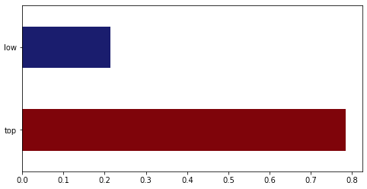
Ratings > 90
Notes:
Photo is replaceable, behind the blue filter.
Click on photo –> Picture format – Change picture
For external presentations, choose a relevant photo for which we own the copyrights to.

Slide 8
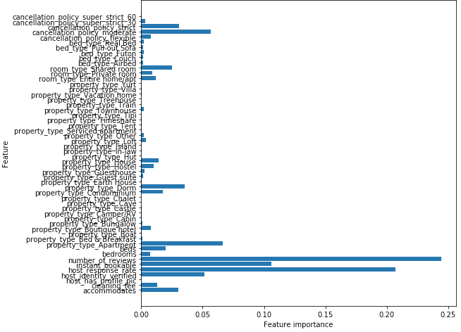
Feature Importance
Notes:
Photo is replaceable, behind the blue filter.
Click on photo –> Picture format – Change picture
For external presentations, choose a relevant photo for which we own the copyrights to.

Slide 9
Business Recommendations
Consider:
The number of reviews
Host response rate
Possibility to book instantly
Notes:
Photo is replaceable, behind the blue filter.
Click on photo –> Picture format – Change picture
For external presentations, choose a relevant photo for which we own the copyrights to.

Slide 10
Conclusion
Listings’ rating can be predicted with an accuracy of 78.34%
Notes:
22 years

Slide 11
Use other machine learning algorithms
Consider different data cleaning methods
Try other features from the data set
Next Steps
Notes:
22 years

Slide 12

Thank You
Bedankt
Спасибо
Ďakujeme
Ačiū
Děkujeme
Dziękujemy
Ευχαριστούμε
Gracias
Gràcies
Grazie
Hvala vam
Hvala
Kiitos
Köszönjük
Merci
Obrigado
Paldies
Salamat
Tack
Tak
Takk
Takk fyrir
Aitäh
Terima kasih
Teşekkürler
Vă mulţumim
Danke
Xin cám ơn
Благодарим Ви
ขอบคุณ
הדות
謝謝您
谢谢您
감사합니다
Дякуємо
ありがとうございます
Hvala
Obrigado
Terima kasih
Gracias
شكرًا

